Slide 1
Report on Pizza Sales Analysis
Prepared by Shakil Ahammed

Slide 2
In this project I have utilized SQL queries to solve questions that were related to pizza sales.

Slide 3

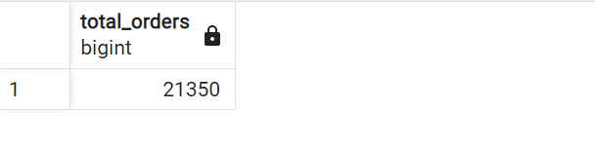
1. Retrieve the total number of orders placed.

Slide 4
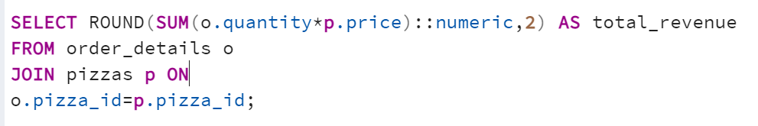

2. Calculate the total revenue generated from pizza sales.

Slide 5
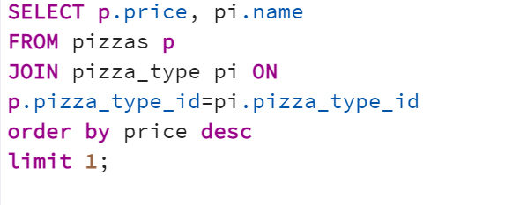
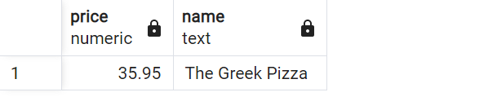
3. Identify the highest-priced pizza.

Slide 6
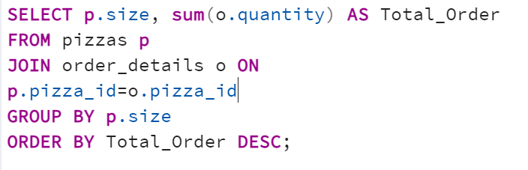
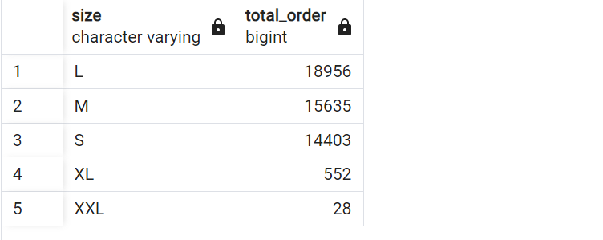
4. Identify the most common pizza size ordered.

Slide 7
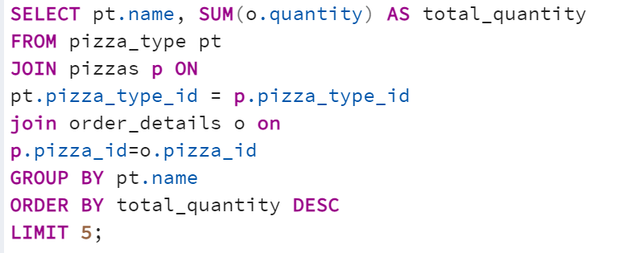
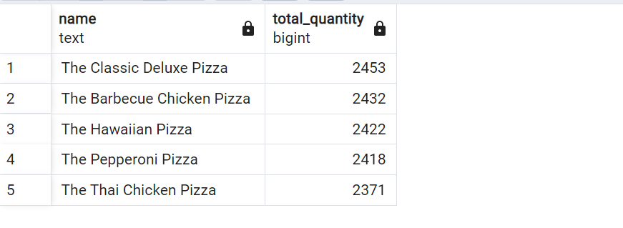
5. List the top 5 most ordered pizza types along with their quantities.

Slide 8
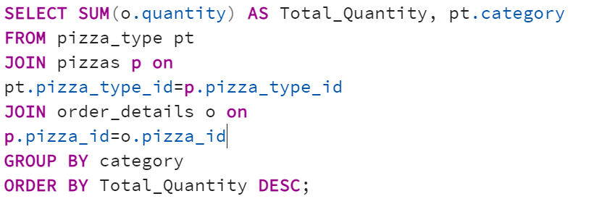
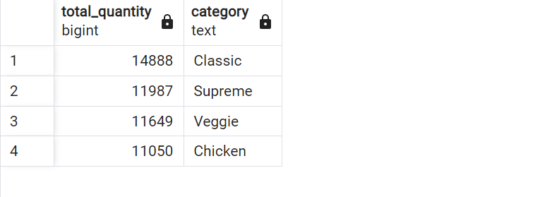
6. Join the necessary tables to find the total quantity of each pizza category ordered.

Slide 9
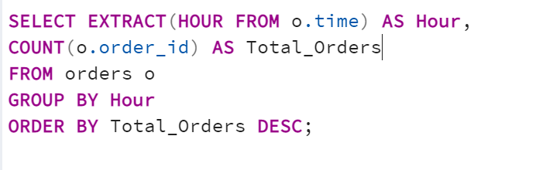
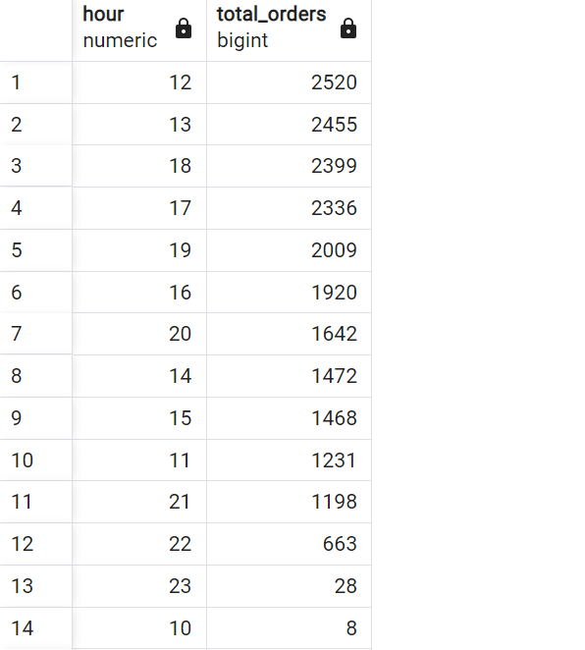
7. Determine the distribution of orders by hour of the day.

Slide 10
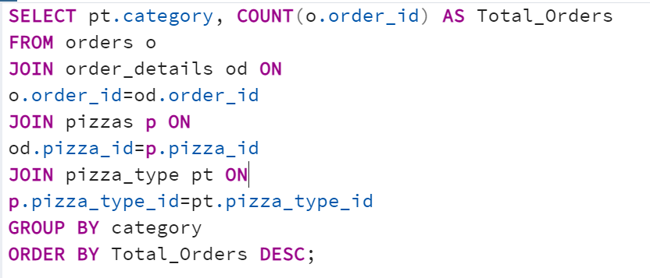
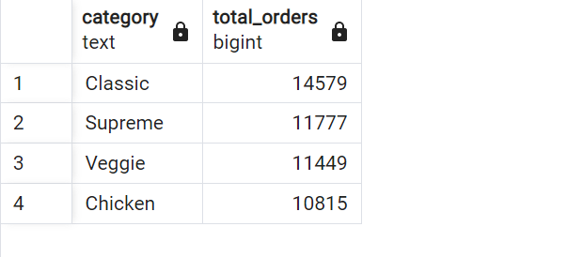
8. Join relevant tables to find the category-wise distribution of pizzas

Slide 11
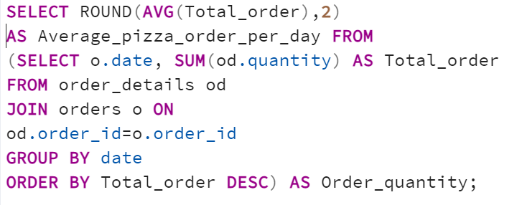
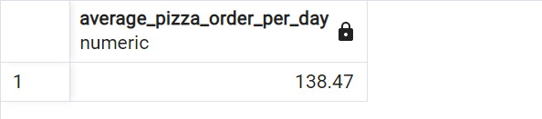
9. Group the orders by date and calculate the average number of pizzas ordered per day.

Slide 12
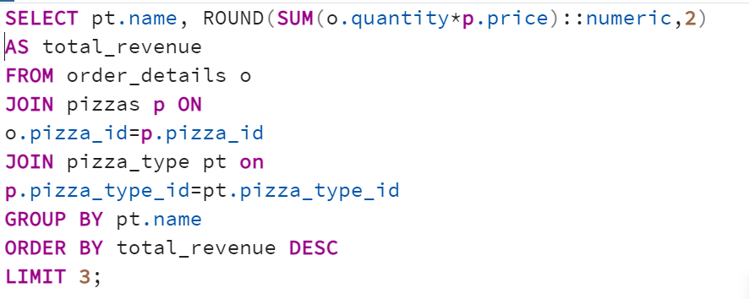
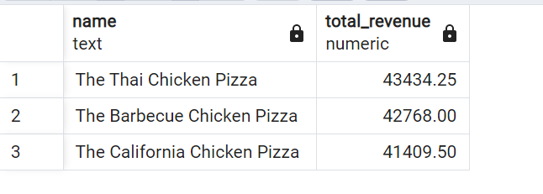
10. Determine the top 3 most ordered pizza types based on revenue.

Slide 13
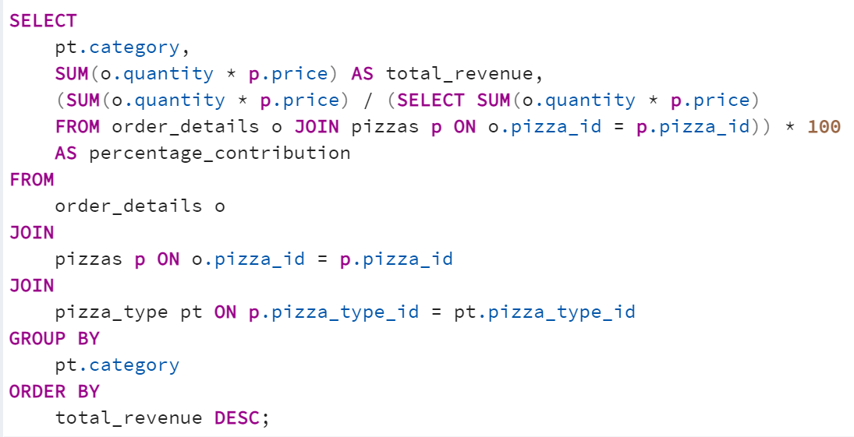
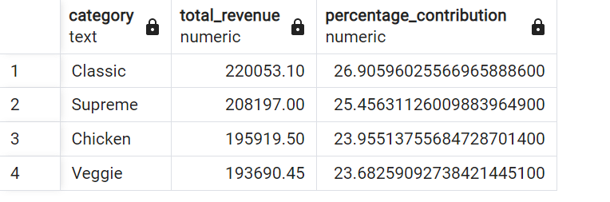
11. Calculate the percentage contribution of each pizza type to total revenue.

